Slide 1
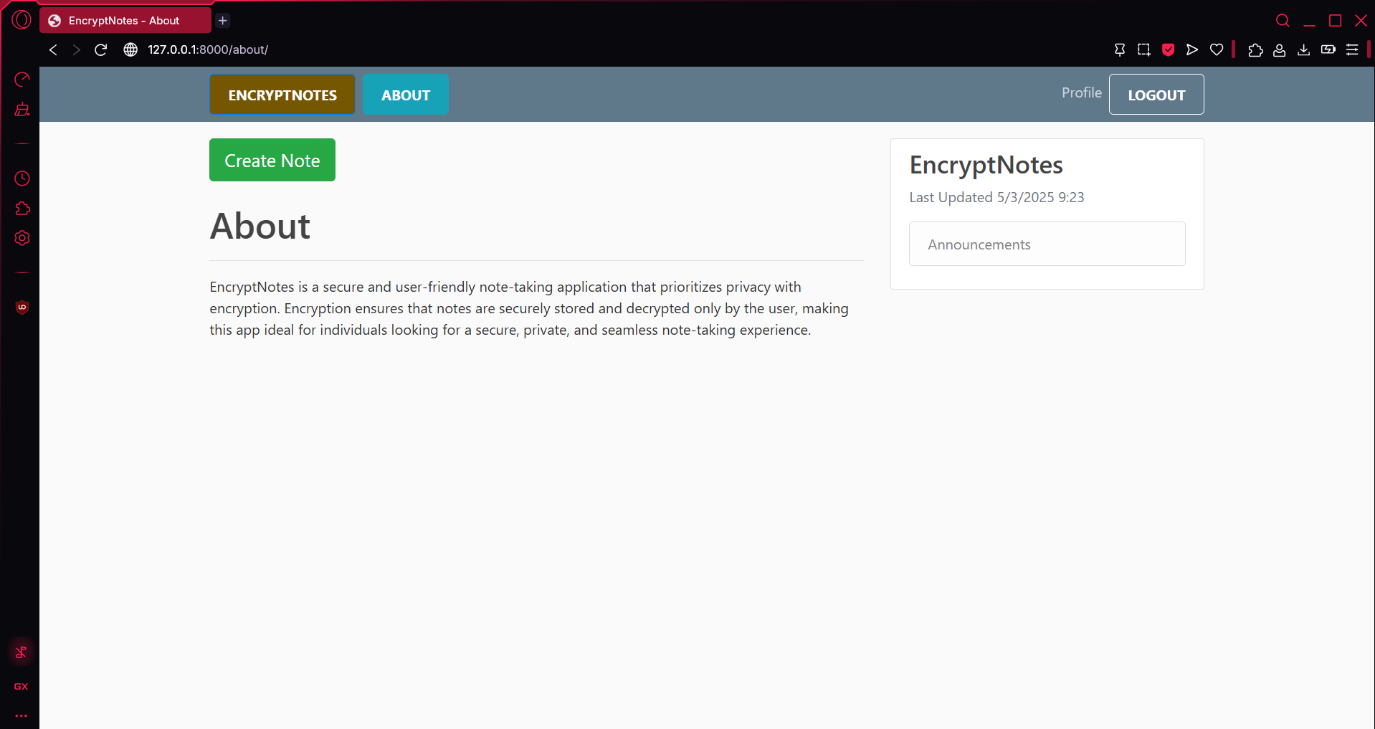
EnCryptNotes Secure and Intelligent Note Management
CPT-200 Team 2 - Phase 4
Notes:
Duncan

Slide 2

What is it?
Secure, AI-powered Note App
Accessed from Web Browser
Privacy & Efficiency Top priorities
Notes:
Duncan

Slide 3

Why EncryptNotes?
Easily accessible
No downloads
Unlike Other apps –
Ours doesn’t lack security
Ours doesn’t have poor organization
Ours has automatic categorization
Notes:
Duncan

Slide 4
Key Features
End to End Encryption
AI-Powered Categorization
User-Controlled Security Setting
Note Editing and Management
User Account Controls
Notes:
Kj

Slide 5
Technical Overview
Application
Powered by Python and Django
User Authentication
Secure authentication with Django
Encryption
Data encrypted before saving to database
Decrypted upon access from database
MySQL Database
Notes:
Kj

Slide 6
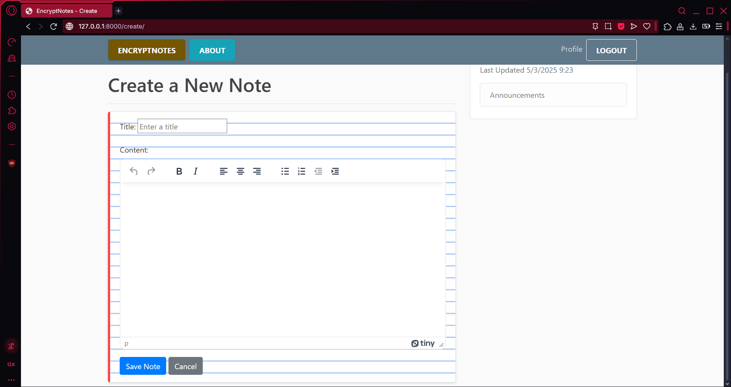
Unique Features
Powerful TinyMCE Editor utilized to create, edit, and view
AI powered note categorization with Google AI
Notes:
Grant

Slide 7
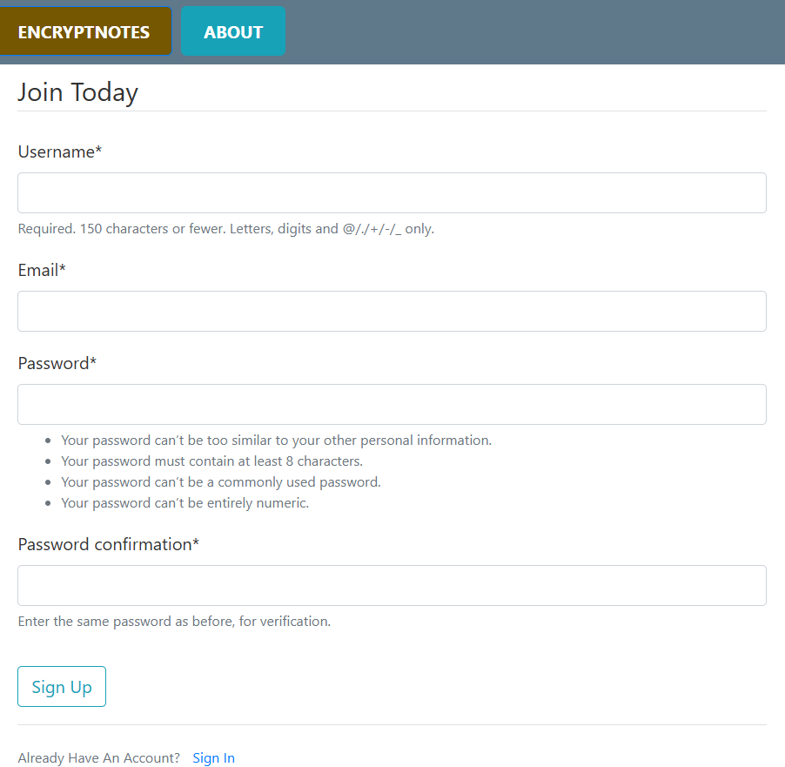
Sign Up Page
Minimum password requirements for enhanced security
Notes:
Grant

Slide 8

Who would use it?
Students – Secure College Notes
Business Professionals – Secure Work Notes
Other Privacy Focused Individual Users
Notes:
Kaden

Slide 9
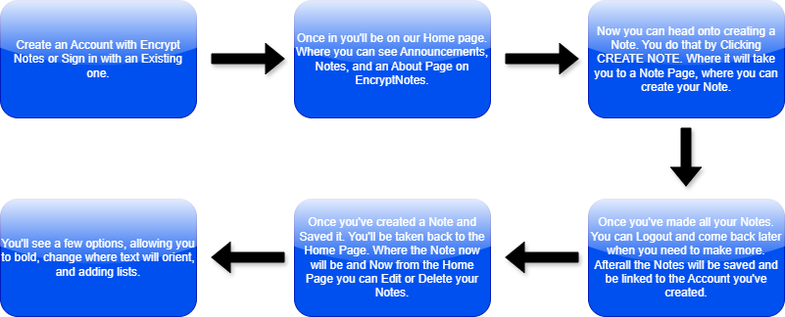
So How Do You Use It?
Notes:
Kaden

Slide 10
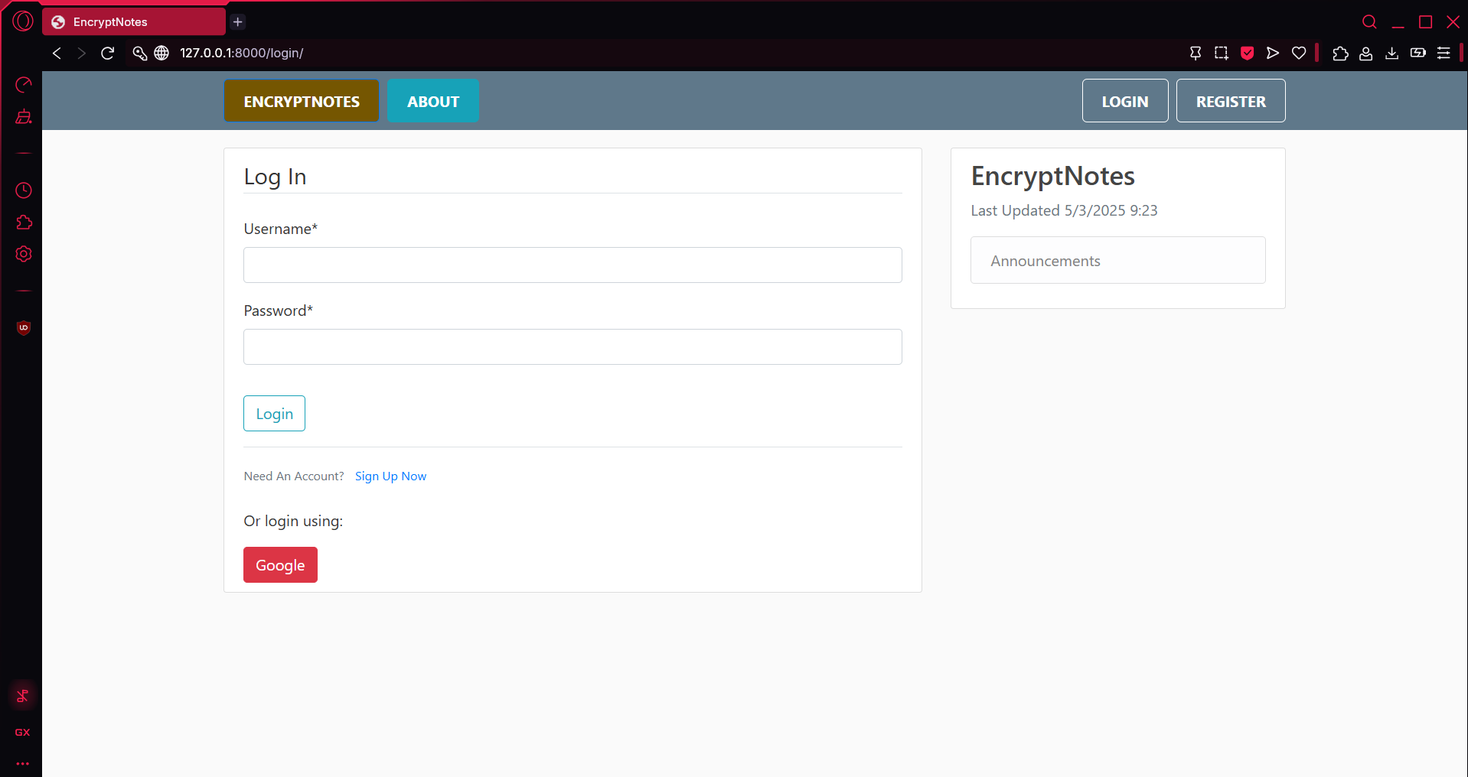
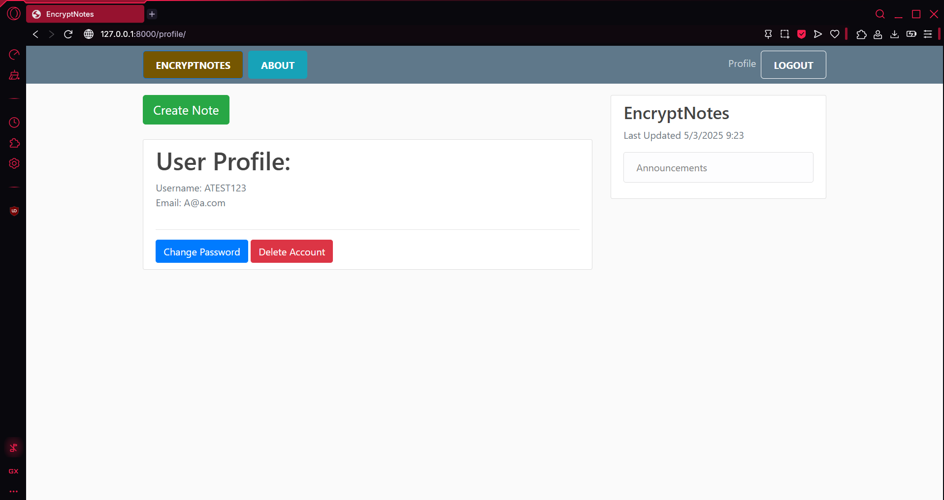
Login/profile page
Here is an Image of the second step.
This is showing the Login page and User page once Logged in.

Slide 11
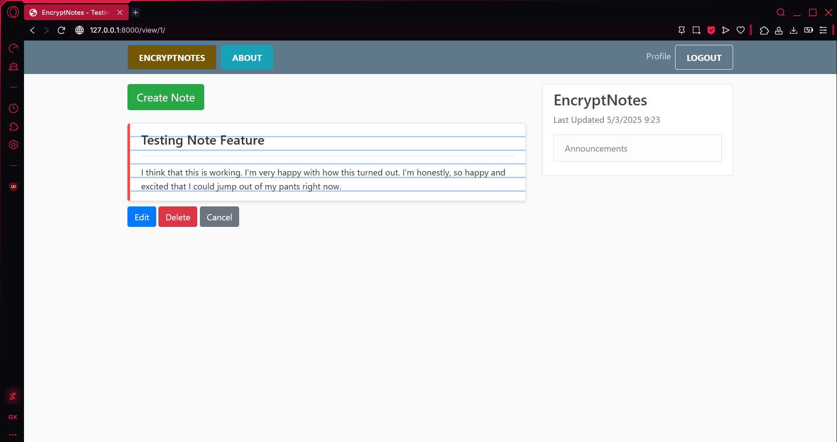
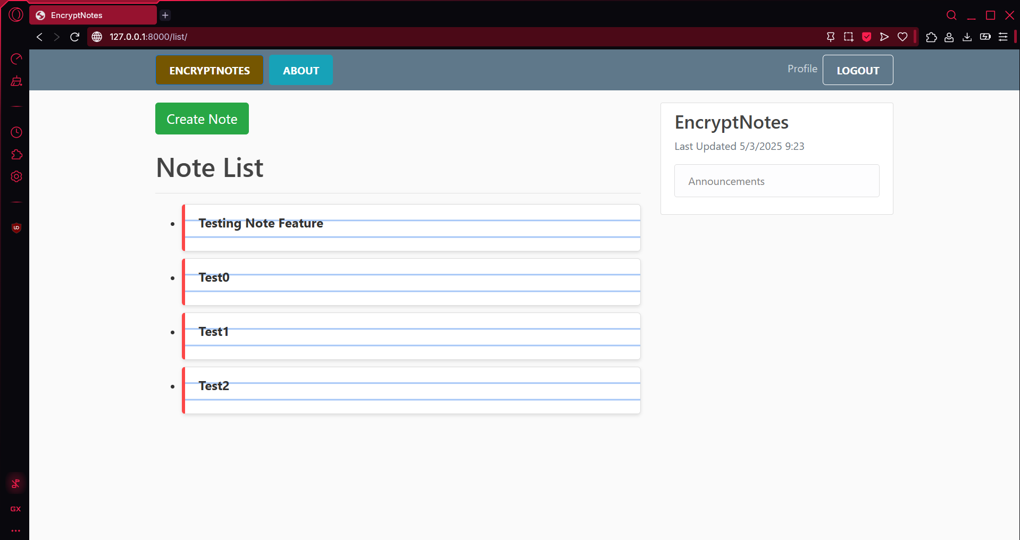
Note Pages

Slide 12
Demo

Slide 13

Questions?

